Slide 1

Welcome to
DPRW

Slide 2
Unit 4 Abstract (2) Writing Techniques
Unit 4

Slide 3
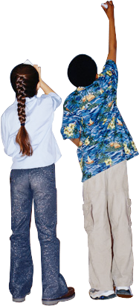
Agenda
I. Objectives
II. Lead-in Activities
III. Lecture
  IV. Follow-up Activity

Slide 4

I. Objectives
After the class, you should be able to:
I. Follow the ”Five Steps” for abstract writing
2. Follow the “5 A Strategy” for abstract writing
3. Avoid likely mistakes and common errors in abstract writing
4. Know about the basic skills for translation from Chinese to English

Slide 5
II. Lead-in Activities
Group discussion
What problems did you find in your abstract writing?
1.
2.
3.

Slide 6
III. Lecture
3.1 “Five Steps” for abstract writing
3.2 “5 A Strategy” for abstract writing
3.3 Likely mistakes and common errors in abstract writing
3.4 Basic skills for translation from Chinese to English

Slide 7
“Five Steps” for abstract writing
Step One: read your introduction to define the
context and the purpose of the study.
Step Two: outline the approach and the procedures of the study.
Step Three: list results, findings, conclusion, and significance
Step Four: draft the abstract
Step Five: check the draft of the abstract to a minimum length.

Slide 8
“5 A Strategy” for abstract writing
Abstract=A1+A2+A3+A4+A5
A1=background in sentence(1)
A2=topic in sentences(2)
A3=approach in sentences(3.4.5)
A4=conclusion in sentences(6.7)
A5=significance in sentences(8)

Slide 9
Samples analysis
When employers focus only on the direct, out-of-pocket costs of
health care, they fail to consider the indirect costs of illness in the
workplace from workers’ impaired functioning on the job and
absenteeism(A1). A case study is presented on the effects of
clinical depression on direct and indirect health-related costs(A2).
A model is provided that employers can apply to a wide range of
illness to analyze their investments in health care(A4). The model
is applied to several workplace situations: employees’ depression,
cigarette smoking breaks, and arthritis, to estimate the costs of
lost productivity(A3). A break-even analysis is also shown when
employers’ investments in health interventions are likely to be
justified(A3). Since health service research is, in many respects,
still in early stages, areas for further research are recommended
at the end of this paper so that more efforts may be exerted(A5).

Slide 10
Likely mistakes and common errors
Informal Writing Style
The colloquial writing style should be avoided in writing abstracts.
Eg.In this paper, we’ve given a reason why the competitive ability of the national firms is weak. Because the non-national firms can get very cheap labor…. So the former can get more profit.
The paper indicates the reason of the weakness of the competitive ability of the national firms. Since the non-national firms can obtain cheaper labor…Therefore,…

Slide 11
Likely mistakes and common errors
Incomplete Content
five basic elements in an abstract, three of which are main ones, namely, topic, approach, and conclusion.
Monotonous Language
Variety is desired,
1. use of long sentences and short ones
2.alternation of passive and active voices
3.variation of words and phrases

Slide 12
Likely mistakes and common errors
Imbalance of Information
Abstract=A1+A2+A3+A4+A5
A1=background in sentence(1)
A2=topic in sentences(2)
A3=approach in sentences(3.4.5)
A4=conclusion in sentences(6.7)
A5=significance in sentences(8)

Slide 13
Basic skills for translation from Chinese to English
Yue Wang

Slide 14
大量使用名词化结构
《当代英语语法》（A Grammar of Contemporary）在论述科技英语时提出，大量使用名词化结构（Nominalization）是科技英语的特点之一。因为科技文体要求行文简洁、表达客观、内容确切、信息量大、强调存在的事实。

Slide 15
1.阿基米德最先发现固体 排水的原理。
Archimeds first discovered the principle of displacement of water by solid bodies.
2.地球绕轴自转，引起昼夜的变化。
The earth rotation on its own axis causes the change from day to night.
3. 炉壁采用耐火砖可大大降低热耗。
If you use firebricks round the walls of the boiler, the heat loss can be considerably reduced.

Slide 16
扩展的名词前置修饰语”Expanded Noun-modifiers
1. 并列式：中心词前的形容词化名词相互之间无修饰关系，并列修饰中心词
手工 筛网 印花
hand screen printing
2. 递进式：
前一个名词依次修饰下一个名词，而形成递加层次
水 泵 阀
例：water pump valve
3. 意群组合式: 中心词之前的修饰语之间存在着比较复杂的修饰与被修饰关系
多波段 多分点 分配 服务
例：Multi-channel Multipoint Distribution Server

Slide 17
广泛使用被动语句
根据英国利兹大学John Swales 的统计，科技英语中的谓语至少三分之一是被动态。这是因为科技文章侧重叙事推理，强调客观准确。第一、二人称使用过多，会造成主观臆断的印象。因此尽量使用第三人称叙述，采用被动语态，

Slide 18
1. 应当注意机器的工作温度。
Attention must be paid to the working temperature of the machine.
而很少说：You must pay attention to the working temperature of the machine . 你们必须注意机器的工作温度。
2.电能可储存在由一绝缘介质隔开的两块金属极板内。这样
的装置称之为电容器，其储存电能的能力称为电容。
Electrical energy can be stored in two metal plates separated by an insulating medium. Such a device is called a capacitor, or a condenser, and its ability to store electrical energy is called capacitance.
Do you know WHY passive voice can be used in Academic Writing?

Slide 19
使用 动词非谓语结构（非限定动词）
科技文章要求行文简练，结构紧凑，为此，往往使用分词短语代替定语从句或状语从句；使用分词独立结构代替状语从句或并列分句；使用不定式短语代替各种从句；介词 + 动名词短语代替定语从句或状语从句。这样可缩短句子，又比较醒目。试比较下列各组句子。

Slide 20
1. 直流电是一种总是沿同一方向流动的电流。
A direct current is a current flowing always in the same direction.
2.热量由地球辐射出来时，使得气流上升。
Radiating from the earth, heat causes air currents to rise.
3.如果没有改变物体运动的原因，那么物体将作匀速直线运动。
A body can move uniformly and in a straight line, there being no cause to change that motion.
4.振动着的物体产生声波，每一次振动产生一个声波。
Vibrating objects produce sound waves, each vibration producing one sound wave.
5.在通讯系统中，电子学要解决的问题是如何把信息从一个地方传递到另一个地方。
In communications, the problem of electronics is how to convey information from one place to another.
6.结构材料的选择应使其在外界条件中保持其弹性。
Materials to be used for structural purposes are chosen so as to behave elastically in the environmental conditions.
7.将能量从一种形式转变成另一种形式有各种不同的方法。
There are different ways of changing energy from one form into another.
8.使无线电波依次对每一个声音作出相应变化时，信息就由广播电台传递到接收机。
In making the radio waves correspond to each sound in turn ,messages are carried from a broadcasting station to a receiving set.

Slide 21
Translation from Chinese-English 5 steps
1. locate conjunctions to separate main and clause.
2. locate verb and non-verb
3.locate subject and object
4.locate others for modification
5.adverbials first then attibutives, and short attributives inverted while long ones in order

Slide 22
主语从句（It-that-结构句）
It is evident that a well lubricated bearing turns more easily than a dry one .
显然，润滑好的轴承，比不润滑的轴承容易转动。
It seems that these two branches of science are mutually dependent and interacting .
看来这两个科学分支是相互依存，相互作用的 It has been proved that induced voltage causes a current to flow in opposition to the force producing it.
已经证明，感应电压使电流的方向与产生电流的磁场力方向相反。
It was not until the 19th century that heat was considered as a form of energy
直到十九世纪人们才认识到热是能量的一种形式。

Slide 23
科技英语长句汉译英的翻译方法
顺序法、逆序法和融合法
Yue Wang

Slide 24
顺序法：如果原文的叙述层次跟汉语相近，就可以按照原文的层次翻译，这是顺序翻译法。
这个简单事实证明，摩擦力去除的越多，球会滚的越远；由此我们可以推论出，如果一切起阻碍作用的引力和阻力能够去除的话，就没有理由认为处于运动中的球还会停下来。
This simple fact shows that the more the force of friction is got rid of， the farther the ball will travel， and we are led to infer that if all the impeding forces of gravitation and resistance can be removed, there is no reason to believe that the ball, once in motion, should ever stop.
同时运用其他各种翻译技巧，例如增词法、词类转换法等。

Slide 25
practice
所有钢铁产品都以其含铁为主要成份，但由于碳和其它元素的含量不同，钢铁冶炼方法不同以及加工过程不同，从而改变了它们的特性，以致于有多种不同的钢铁，其中有些钢铁的特性极不相同，看上去就象不同的金属一样。
commercial iron and steel ; constituent; characteristic properties

Slide 26
所有钢铁产品都以其含铁为主要成份，但由于碳和其它元素的含量不同，钢铁冶炼方法不同以及加工过程不同，从而改变了它们的特性，以致于有多种不同的钢铁，其中有些钢铁的特性极不相同，看上去就象不同的金属一样。
All commercial iron and steel contains iron as chief constituent, but owing to the differences in the percentages of carbon and other elements and the methods by which iron and steel is produced, as well as the processes to which they may be subjected, the characteristic properties have so much change that there are many distinct forms of iron and steel, some of which have properties so different as to appear like different metals. (original)

Slide 27
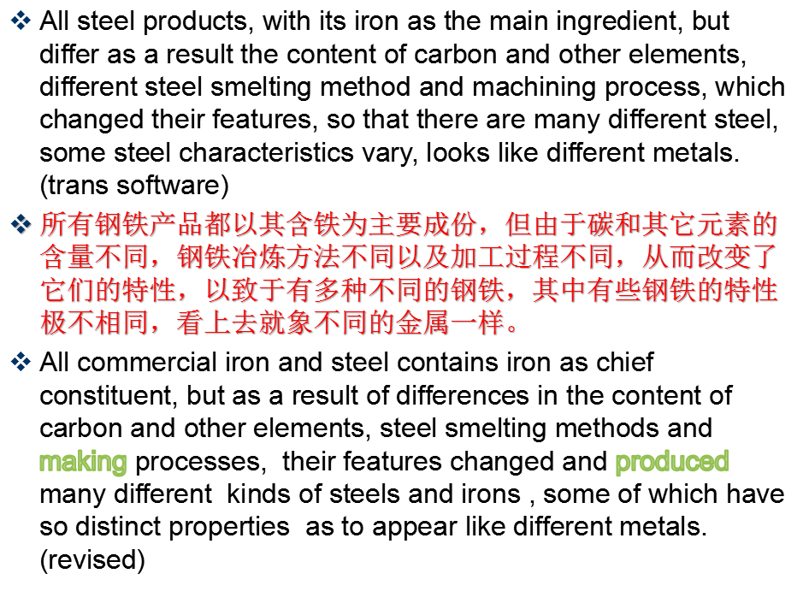

Slide 28
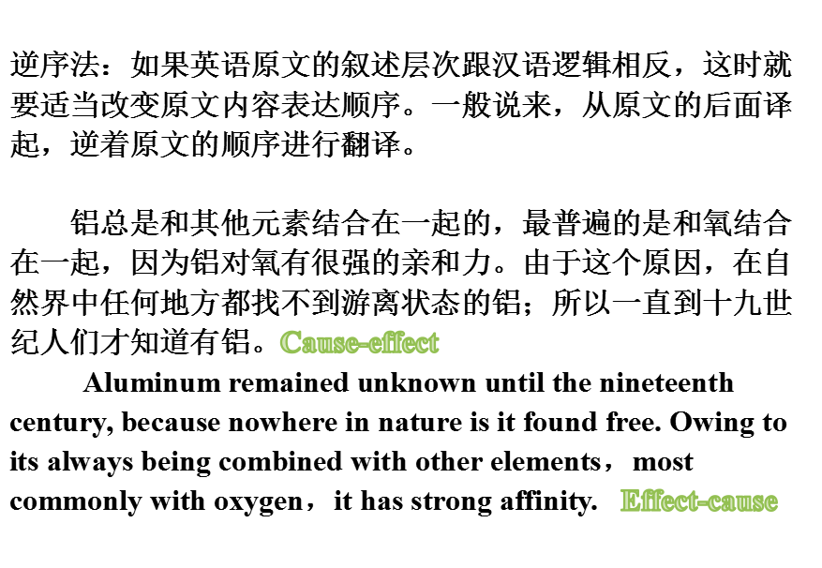

Slide 29
practice
现代科学的一切成就不仅提供了能够承受高温高压的材料，而且也提供了新的工艺过程。依靠这些现代科学的成就，我们相信完全可以制造出这样的人造卫星。
withstand
new technological processes
achievements of contemporary science

Slide 30
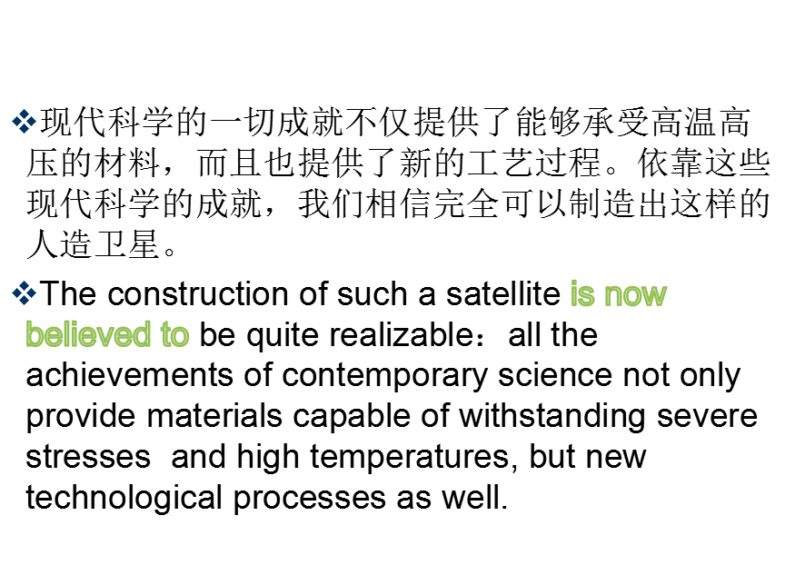

Slide 31
All of modern science has not only provided the material to withstand high temperature and high pressure, but also provide a new technological process.Rely on the achievements of modern science, we believe that can create such a satellite.
现代科学的一切成就不仅提供了能够承受高温高压的材料，而且也提供了新的工艺过程。依靠这些现代科学的成就，我们相信完全可以制造出这样的人造卫星。
Relying on the achievements of modern science, we believe that such a satellite can be manufactured. All of modern science has not only provided the material to withstand high temperature and high pressure, but also provided a new technological process.

Slide 32
融合法：汉语中常把比较复杂的概念，运用一连串的短句，顺序基本不变，保持前后的连贯。翻译成英语时用“形合”代替“意合”。
通常炼铁的地方也炼钢。因此，现代炼钢厂是一个配套的整体，从运进原料到生产各种类型的铸铁与钢材，有的送往其它工厂进一步加工处理，有的就制成成品，如工字钢及其他一些成材。
Steel is usually made where the iron is smelted, so the modern steelworks forms a complete unity, taking in raw materials and producing all types of cast iron and steel, both for sending to other works for further treatment, and as finished products such as joist and other consumers.

Slide 33
practice
一个结构受到的荷载可分为静载与活载两类。静载包括该结构物各部分的重量。活载则是由于人及可移动设备等的重量而引起的荷载。
dead loads
live loads
movable equipment

Slide 34
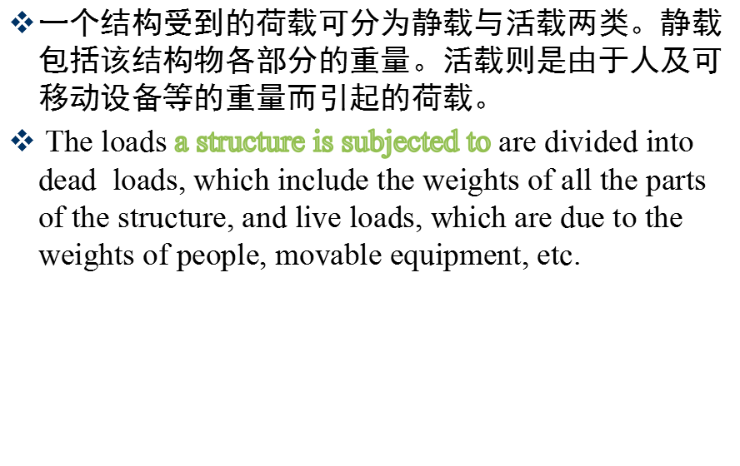

Slide 35
A structure by the load can be divided into two categories, dead load and live load.Static load includes the weight of each part of the structures.Live load are caused by people and mobile equipment caused by the weight of the load.
一个结构受到的荷载可分为静载与活载两类。静载包括该结构物各部分的重量。活载则是由于人及可移动设备等的重量而引起的荷载。
A structure by the load can be divided into two categories, dead load and live load.Static load includes the weight of each part of the structures.Live load are the load caused by people and mobile equipment

Slide 36
IV. Follow-up Activity
Translate your Chinese Abstract into English by using the skills learned today.

Slide 37
Thank You !

